Slide 1
2023-04-24

Slide 2
Upcoming Schedule
Monday | Wednesday | Friday
04/24/2023 (90) • Review: Unit 8 • AP CS Question 4: 2D Array | 04/26/2023 (90) • AP CS Multiple Choice Game | 04/28/2023 (45) • Review: Unit 7, Unit 10 • Algorithms: Iterative/recursive binary search, selection sort, insertion sort, merge sort
05/01/2023 • FINAL | 05/03/2023 • AP EXAM

Slide 3
Unit 8
AP CS FRQ 4 (2D Array)

Slide 4
8.1
Two-Dimensional Arrays

Slide 5
Arrays
0
1
2
Arrays are a zero-based indexed sequence of values of the same type. Any Java type! (Well, not void. But all other primitive or reference types.)
type[] name;
Examples:
boolean[] answers; String[] questions; int[] scores; Student[] students;
v
v
v

Slide 6
Array of Arrays
0
1
2
Arrays are a type, too. So, an array can be declared with arrays as its values. The result? Two-dimensional arrays!
type[][] name;
Examples:
boolean[][] theaterSeats; String[][] seatingChart; int[][] bingoCard; Apt[][] building;
v
v
v
v
v
v
v
v
v

Slide 7

2D Arrays
In Java, a two-dimensional array is really a one-dimensional array of one-dimensional arrays.
Conceptually, though, such arrays are used to model two-dimensional concepts, and we think of it as a single table with rows and columns.
At the Java level, it's actually an outer array where each element is a reference to a nested inner array.

Slide 8
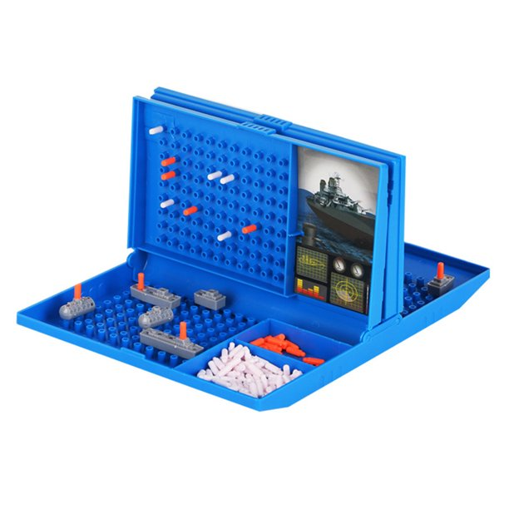


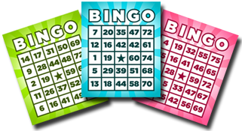
What are 2D arrays good for?

Slide 9
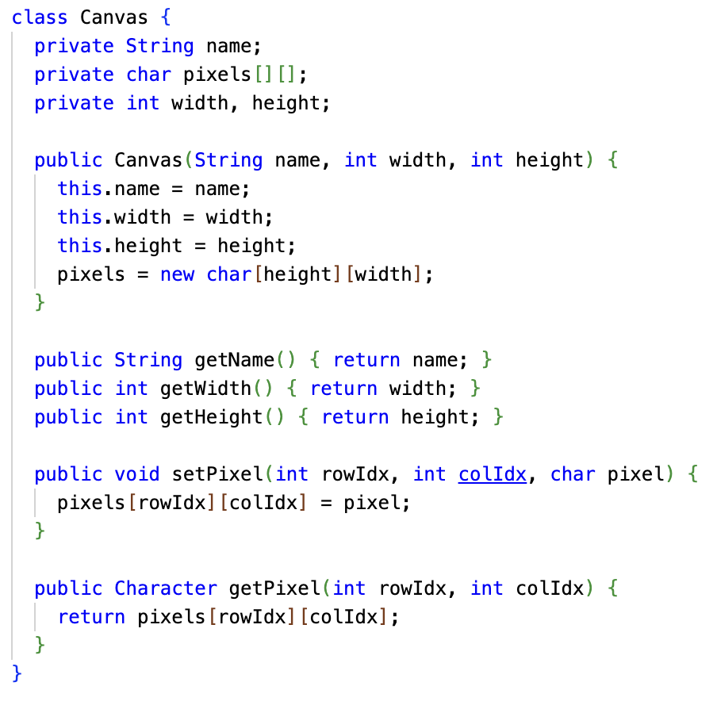
Here's the conventional 2D array approach to the ASCII Art Canvas.
Use rows and cols directly to access the underlying data.
Since row is the outer dimension, this is called row-major order.

Slide 10
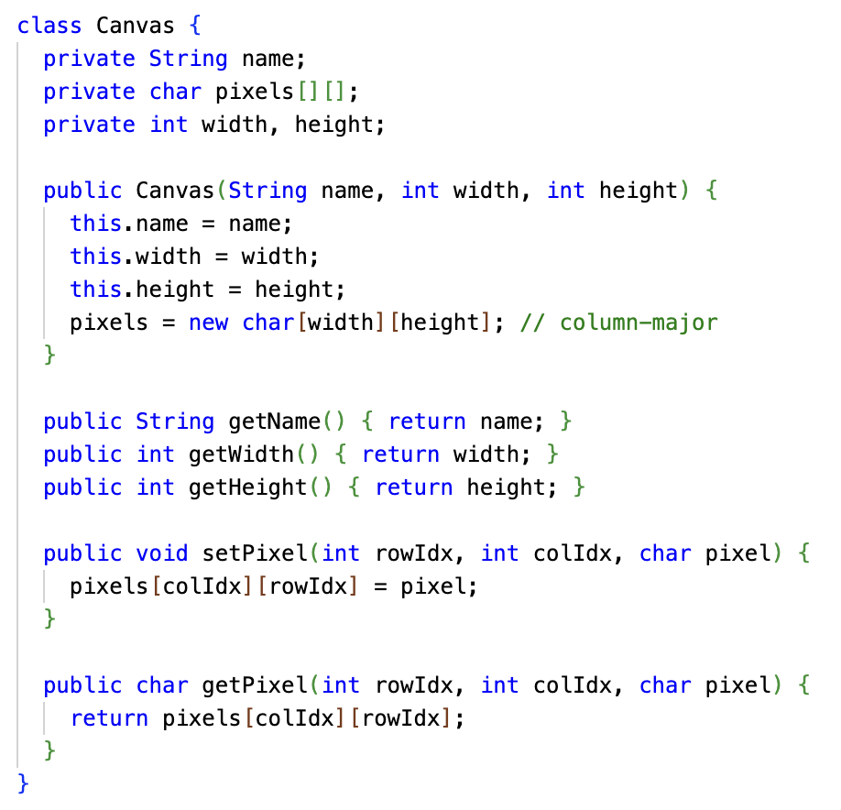
It is also possible to implement the ASCII Art Canvas in column-major order.
Here, the outer array represents the columns, and the inner arrays are the rows!
Row-major is more common, and on the AP exam, assume row-major unless it says otherwise.
IRL whether row-major or column-major is used depends on what the array is being used for, as well as the programmer's mental model.

Slide 11
Array types of array types
Object
Object[]
Every type T in Java has a related array type T[]
Examples: int and int[], String and String[]
But... this is ALSO true for array types themselves!
T[] has a related array type T[][]
T[][] is an array of T[]
type[][] name;
Examples
boolean[][] theaterSeats; <- array of boolean[] String[][] seatingChart; <- array of String[] int[][] bingoCard; <- array of int[] Apt[][] building; <- array of Apt[]
String
String[]

Slide 12
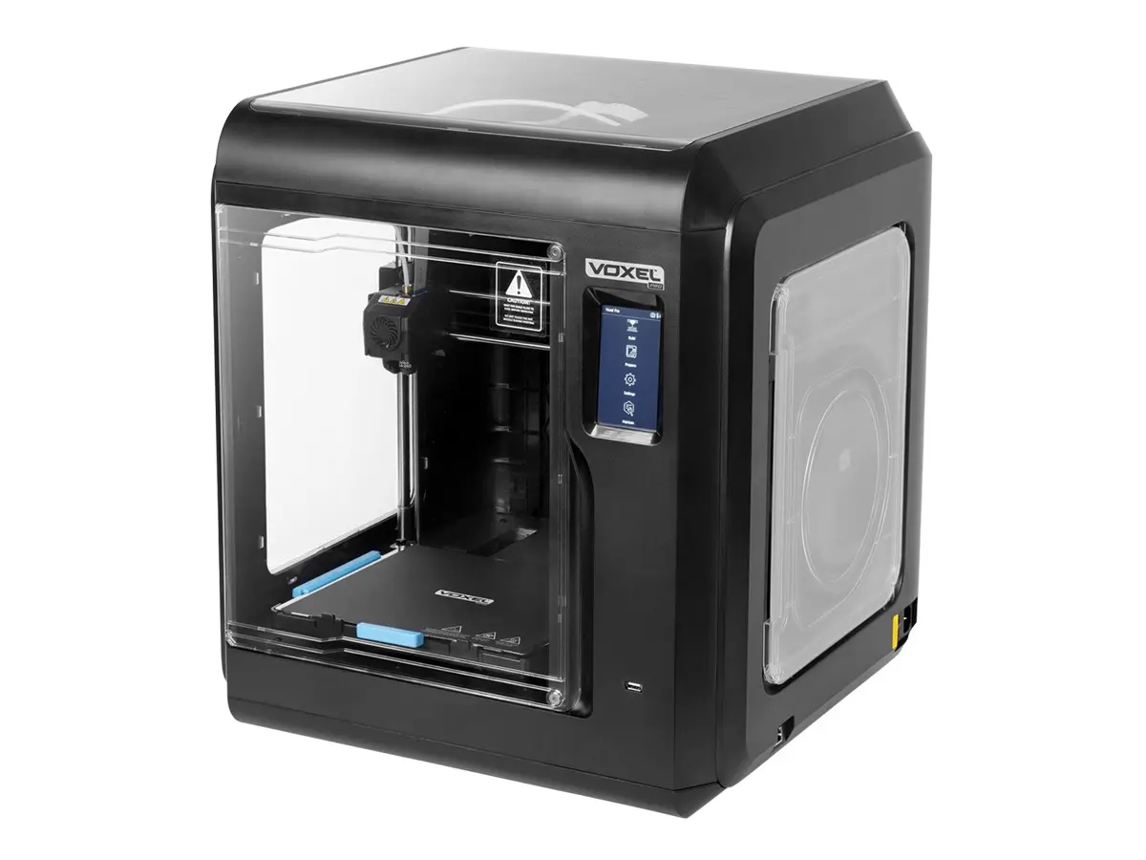
Multi-Dimensional Arrays
You don't have to stop at two dimensions...
The type T[][][] is an array of T[][]
Example: A 3D printer prints "voxels", three-dimensional pixels. Software for a 3D printer might store a model in memory in a 3-dimensional array.
Voxel[][][] voxels;
A Minecraft-like game might store an animation as frames of 3D voxels, but over time. So, a 4-dimensional array:
Voxel[][][][] voxelAnimationFrames;
Two-dimensional arrays are the most common multi-dimensional arrays, though. (And it's the most dimensions you'll see on the AP Exam.)

Slide 13
Array of Arrays - Definition
boolean[][] theaterSeats = new boolean[numRows][numSeatsPerRow];
String[][] seatingChart = new String[numRows][numSeatsPerRow];
int[][] bingoCard = new int[5][5];
Apt[][] building = new Apt[numFloors][numAptsPerFloor];
* NOTE 1 *
Two-Dimensional Arrays can have non-equal dimensions!
boolean[][] theaterSeats = new boolean[75][25];
String[][] seatingChart = new String[5][10];
int[][] multiplicationTable = new int[100][500];
Apt[][] building = new Apt[5][10];

Slide 14
Array of Arrays - Definition
boolean[][] theaterSeats = new boolean[numRows][numSeatsPerRow];
String[][] seatingChart = new String[numRows][numSeatsPerRow];
int[][] bingoCard = new int[5][5];
Apt[][] building = new Apt[numFloors][numAptsPerFloor];
* NOTE 2 *
Just like Arrays - Two-Dimensional Arrays initialize their values to "reasonable" defaults
0 for numeric types null for Object types false for boolean types

Slide 15
Array of Arrays - Definition
int[][] bingoCard = new int[5][5]; Alternatively... int[][] bingoCard = new int[5][]; // omit internal array size bingoCard[0] = new int[5]; bingoCard[1] = new int[5]; bingoCard[2] = new int[5]; bingoCard[3] = new int[5]; bingoCard[4] = new int[5];

Slide 16
Array of Arrays - Definition
boolean[][] theaterSeats = new boolean[numRows][numSeatsPerRow]; Alternatively... boolean[][] theaterSeats = new boolean[numRows][]; for (int rowIdx = 0 ; rowIdx < numRows ; rowIdx++ { theaterSeats[rowIdx] = new boolean[numSeatsPerRow]; }

Slide 17
Arrays of Arrays - Example
boolean[][] theaterSeats = new boolean[rows][seats];
theaterSeats[0]
theaterSeats[0][0]
theaterSeats[0][...]
theaterSeats[0][seats-1]
false
false
false
theaterSeats[...]
theaterSeats[...][0]
theaterSeats[...][...]
theaterSeats[...][seats-1]
false
false
false
theaterSeats[rows-1]
theaterSeats[rows-1][0]
theaterSeats[rows-1][...]
theaterSeats[rows-1][seats-1]
false
false
false
Write: theaterSeats[0][0] = true; Read : System.out.println(theaterSeats[rows-1][seats-1]);

Slide 18
Arrays of Arrays - Initializer Lists
You can initialize the values of a Two-Dimensional Array when you create it (and the sizes will be automatically calculated)
int[][] ticketInfo = { {25,20,25}, {25,20,25} }; ticketInfo.length => 2 ticketInfo[0].length) => 3 ticketInfo[1].length) => 3
boolean[][] jaggedTable = { {false, true, true}, {false}, {true} }; jaggedTable.length => 3 jaggedTable[0].length) => 3 jaggedTable[1].length) => 1 jaggedTable[2].length) => 1

Slide 19
Arrays of Arrays - Jagged Arrays
On the exam all inner arrays will have the same length - However it is possible in Java to have inner arrays of different lengths. These are called Jagged (or Ragged) Arrays. You can assume 2D arrays on the exam are NOT jagged.
int jaggedTable[][] = new int[3][]; // omit the inner array size jaggedTable[0] = new int[6]; jaggedTable[1] = new int[2]; jaggedTable[2] = new int[5];
jaggedTable.length => 3 jaggedTable[0].length => 6 jaggedTable[1].length => 2 jaggedTable[2].length => 5

Slide 20
2D array dimensions
On the AP exam, all inner arrays will have the same length. So, you can use the length of the first row, if any, to determine the number of columns in a 2D array. You may safely assume the rest of the rows will have the same number of columns.
int grid[][] = new int[3][7]; ...
int numRows = grid.length; > 3
int numCols = grid[0].length; > 7

Slide 21
8.2
Traversing
Two-Dimensional Arrays

Slide 22


Review: Traversing Arrays with for loops
Remember that the range of valid Array indexes (for non-empty Arrays) is 0 to Array.length - 1
int scores[] = {95, 100, 91, 85 };
for (int idx = 0; idx < scores.length; idx++) {
System.out.println(scores[idx]);
}
int scores[] = {95, 100, 91, 85 };
for (int idx = 1; idx <= scores.length; idx++) {
System.out.println(scores[idx]);
}

Slide 23
Review: Traversing Arrays with for loops
Remember that the range of valid Array indexes (for non-empty Arrays) is 0 to Array.length - 1
int scores[] = {95, 100, 91, 85 };
for (int idx = 0; idx < scores.length; idx++) {
System.out.println(scores[idx]);
}
int scores[] = {95, 100, 91, 85 };
for (int idx = 1; idx <= scores.length; idx++) {
System.out.println(scores[idx]);
}
Note: Passing an out of range index will cause a ArrayIndexOutOfBoundsException!

Slide 24
Review: Traversing Arrays with for loops
Remember that the range of valid Array indexes (for non-empty Arrays) is 0 to Array.length - 1
int scores[] = {95, 100, 91, 85 };
for (int idx = 0; idx < scores.length; idx++) {
System.out.println(scores[idx]);
}
This loop also skips the first element in the Array!
int scores[] = {95, 100, 91, 85 };
for (int idx = 1; idx <= scores.length; idx++) {
System.out.println(scores[idx]);
}
Note: Passing an out of range index will cause a ArrayIndexOutOfBoundsException!

Slide 25
Review: Traversing Arrays with for loops
You can use a for loop to traverse an Array from back to front!
int scores[] = {95, 100, 91, 85 };
for (int idx = scores.length - 1; idx >= 0; idx--) {
System.out.println(scores[idx]);
}
...or to traverse any arbitrary range of elements
int scores[] = {95, 100, 91, 85 };
for (int idx = 1; idx <= 2; idx++) {
System.out.println(scores[idx]);
}

Slide 26
Traversing Two-Dimensional Arrays with for loops
Traversing Two-Dimensional Arrays is very similar
int scores[ ][ ] = { {10,20,30},{40,50,60} };
for (int idx = 0; idx < scores.length; idx++) { for (int jdx = 0; jdx < scores[idx].length; jdx++) {
System.out.println(scores[idx][jdx]); }
}
Typically start at index = 0
& don't exceed length-1
Note: Passing an out of range index will cause a ArrayIndexOutOfBoundsException!

Slide 27
Review: Traversing Arrays with for-each loops
for (type arrayItemVariable : arrayVariable) { arrayItemVariable resolves to arrayVariable[...] }
String[] colors = {"red", "orange", "purple"}; System.out.println("begin"); for(String color: colors){ System.out.println(" " + color); } System.out.println("end");

Slide 28
Review: Traversing Arrays with for-each loops
The type of the for-each variable MUST match the type of the values stored in the Array
String colors[] = {"red", "orange", "purple"}; for(int color: colors){ System.out.println(" " + color); }
Note: color must be of type String since colors is an Array that contains Strings

Slide 29
Traversing Two-Dimensional Arrays with for-each loops
Remember during the introduction of Two-Dimensional Arrays - We said: "Arrays are a type - Which means you can easily create an Array that contains Arrays - often called Two-Dimensional Arrays"
That means we can use for-each to traverse a Two-Dimensional Array almost exactly like a One-Dimensional Array (we just have to be careful how we declare the types)
Reminder: for-each loops can be super-useful; but you are unable to make use of an index or change the underlying Array while looping

Slide 30
Traversing Two-Dimensional Arrays with for-each loops
Given this Two-Dimensional Array
int scores[][] = {{10,20,30},{40,50,60}};
And this general description of for-each
for (type arrayItemVariable : arrayVariable) { arrayItemVariable resolves to Array[...] }
Q: What is the type of the outer array in scores?
scores[] -> an array of int[]
Q: What is the type of the inner array in scores?
scores[][] -> an array of int

Slide 31
Traversing Two-Dimensional Arrays with for-each loops
int scores[][] = {{10,20,30},{40,50,60}};
scores[] -> an array of int[] scores[][] -> an array of int
So we can use for-each to traverse the Two-Dimensional Array like this
for (int[] outer : scores) {
for (int inner : outer) {
System.out.println(inner);
} }
Note: The inner array is a One-Dimensional Array - So we use the same for-each that we used previously for One-Dimensional Arrays
for (type arrayItemVariable : arrayVariable) { arrayItemVariable resolves to arrayVariable[...] }
No indices available for use!

Slide 32
Traversal of Jagged Arrays
Traversal of Two-Dimensional Jagged Arrays works the same!
int jaggedTable[][] = new int[3][]; jaggedTable[0] = new int[]{4,1,5,9,6,3}; jaggedTable[1] = new int[]{9,1}; jaggedTable[2] = new int[]{0,3,2,9,4}; for (int idx = 0; idx < jaggedTable.length; idx++) { for (int jdx = 0; jdx < jaggedTable[idx].length; jdx++) { System.out.print(jaggedTable[idx][jdx] + " "); } System.out.println(); }
4
1
5
9
6
3
9
1
0
3
2
9
4

Slide 33
Example: Basketball Scores (Row-Major)
int NUM_PLAYERS = 5, NUM_GAMES = 3; int scores[][] = new int[NUM_PLAYERS][NUM_GAMES];
scores[][]
 | Game 1 | Game 2 | Game 3
Player 1 | 14 | 19 | 22
Player 2 | 24 | 13 | 5
Player 3 | 5 | 26 | 31
Player 4 | 0 | 18 | 40
Player 5 | 15 | 9 | 46

Slide 34
Example: Basketball Scores (Row-Major)
int NUM_PLAYERS = 5, NUM_GAMES = 3; int scores[][] = new int[NUM_PLAYERS][NUM_GAMES];
scores[3][0], scores[3][1], scores[3][2]
 | Game 1 | Game 2 | Game 3
Player 1 | 14 | 19 | 22
Player 2 | 24 | 13 | 5
Player 3 | 5 | 26 | 31
Player 4 | 0 | 18 | 40
Player 5 | 15 | 9 | 46

Slide 35
Example: Basketball Scores (Row-Major)
int NUM_PLAYERS = 5, NUM_GAMES = 3; int scores[][] = new int[NUM_PLAYERS][NUM_GAMES];
scores[0][1], scores[1][1], scores[2][1], scores[3][1], scores[4][1]
 | Game 1 | Game 2 | Game 3
Player 1 | 14 | 19 | 22
Player 2 | 24 | 13 | 5
Player 3 | 5 | 26 | 31
Player 4 | 0 | 18 | 40
Player 5 | 15 | 9 | 46

Slide 36
Example: Basketball Scores (Row-Major)
int NUM_PLAYERS = 5, NUM_GAMES = 3; int scores[][] = new int[NUM_PLAYERS][NUM_GAMES];
 | Game 1 | Game 2 | Game 3
Player 1 | 14 | 19 | 22
Player 2 | 24 | 13 | 5
Player 3 | 5 | 26 | 31
Player 4 | 0 | 18 | 40
Player 5 | 15 | 9 | 46
Q1: How would you determine the total points scored by all 5 players in all 3 games?
Q2: How would you determine which player had the highest number of points in Game 3?
Q3: How would you determine the average points scored by Player 3 in all 3 games?

Slide 37
AP CS FRQ 4 (25 minutes)
2022 AP Computer Science A - Free-Response Questions
Complete (4.A) and (4.B)

Slide 38
AP CS FRQ 4 - Review (15 minutes)
Sample Responses and Scoring Commentary - FRQ-4

